Slide 1



Module Title
Topic 3:
Designing and Developing for Mobile Websites
Notes:
NCC Education - Title Master

Slide 2
Scope and Coverage
This topic will cover:
  Designing and developing for mobile websites:
    CCS3
    Flexible layouts
    Resizing and adjustments
    Code to redirect mobile users
    Location map
    Web form
Notes:
NCC Education - Slide Master

Slide 3
Learning Outcomes
By the end of this topic students will be able to:
  Design and code a web-based user interface appropriate to a given problem including mobile website.

Slide 4
Introduction to Mobile Websites
  It is a trend now users access the internet and web pages through a mobile device including mobile phones, wearables and tablets.
  Statistics show that more people are using mobile devices than traditional desktop devices.
  Designing web page for mobile devices is a tendency practice as the business can be at risk of loosing users.

Slide 5
Differences between traditional and mobile website
  A mobile website is specifically designed and scaled to function on device screen.
  A mobile website uses fonts and graphics that are easy to navigate and read.
  Some mobile websites considerations:
    Navigation buttons with easy-to-ready print
    Click to call features so that user can touch to dial without having to enter all numbers
    GPS and directions to find the business
    Easy to load streamlined menus

Slide 6
Mobile Website Advantages
  Users can access content specifically designed for mobile devices enabling better user experience.
  The mobile optimised website is easy to use and loads quickly meaning users can perform transactions without visiting the desktop site.
  Businesses without mobile site are likely to loose users and customers.

Slide 7
Mobile Website Considerations
  Consider the restricted viewing space – for example a mobile website tends to be one column of data.
  Use semantic HTML elements for search engine friendly.
  Viewport and flexible layouts are used with Dynamic Image Scaling.
  Consider touch screen rather than mouse and keyboard entry.
  Dropdown menus may work better when displayed in single menu (one column).

Slide 8
Example Basic Mobile Page
<!DOCTYPE html>
<html>
<meta name="viewport" content="width=device-width, initial-scale=1">
<link rel="stylesheet" href="mymobile.css">
<body>
<h1>Zanzibar Zoo</h1>
<p>Welcome to Zanzibar Zoo</p>
</body>
</html>

Slide 9
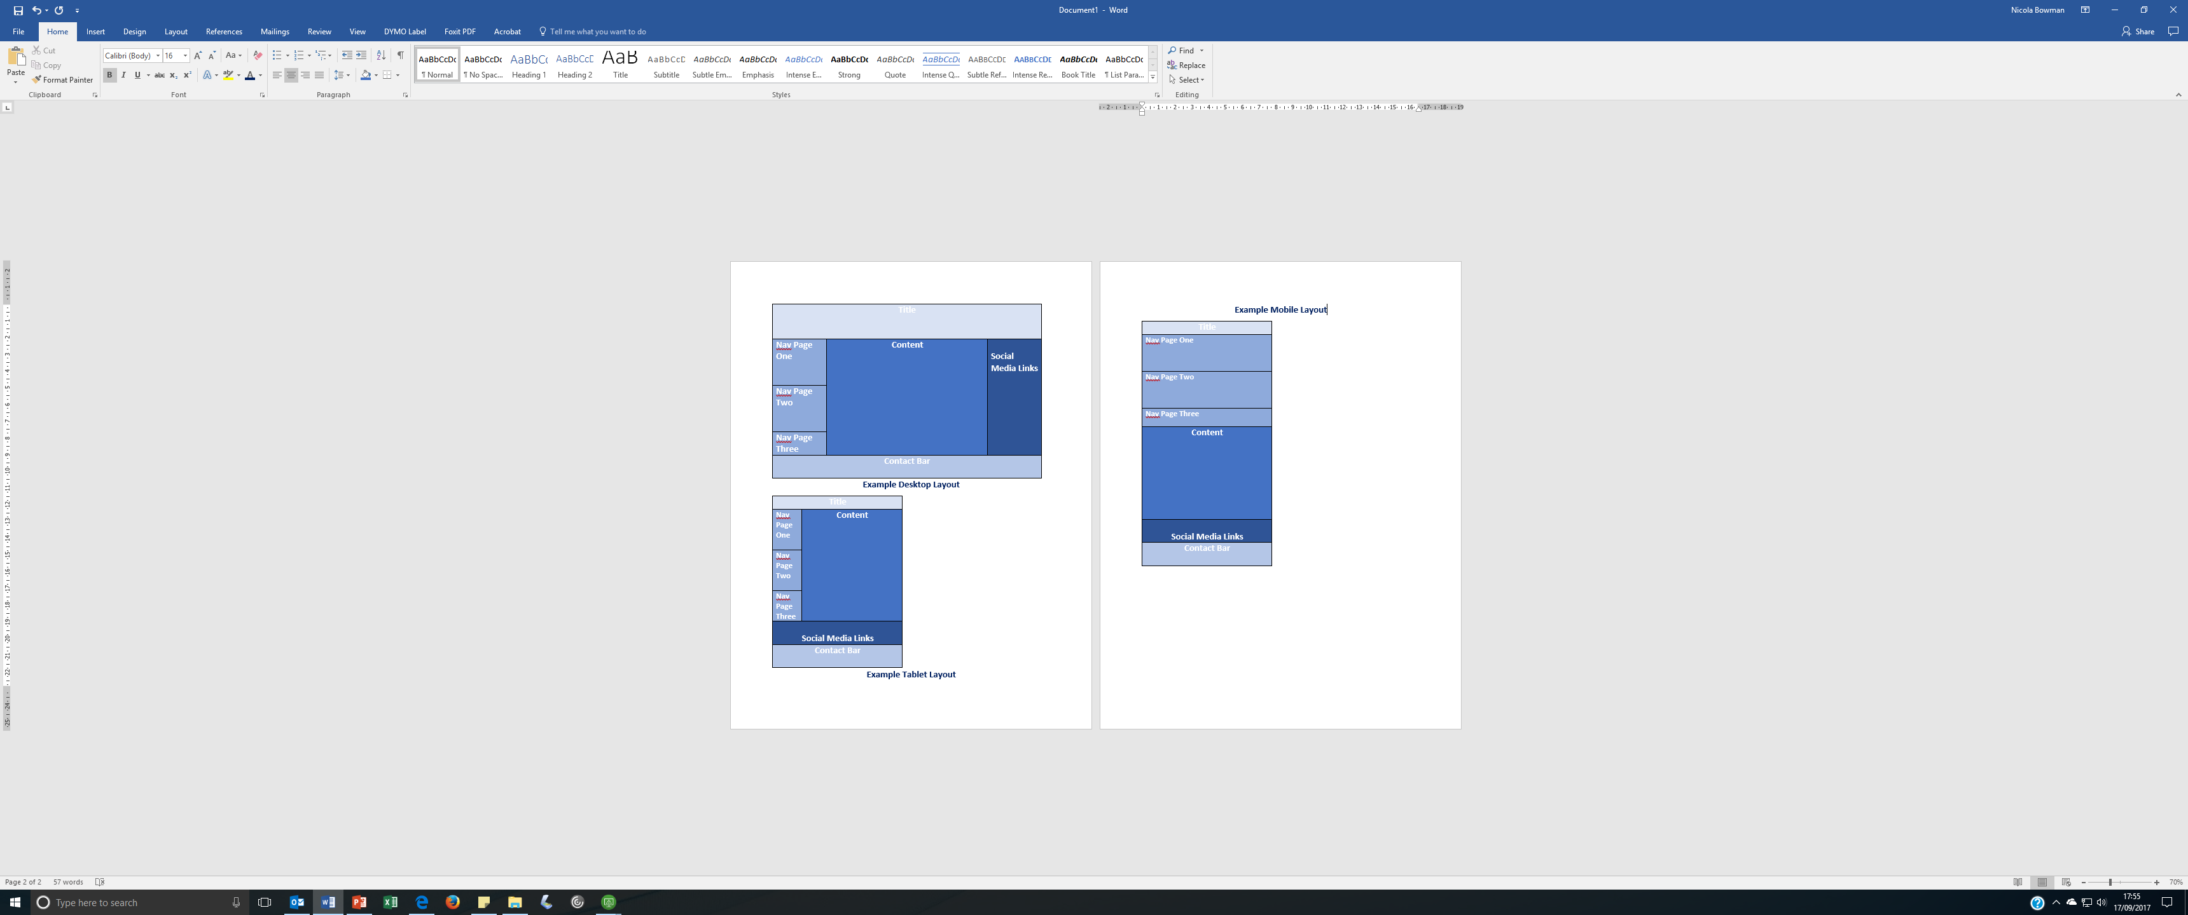
Responsive Design
By using media queries you can set the style for different devices in the one web page.

Slide 10
Viewport
  Viewport is the visible area of a web page to the user on a mobile device. This will depend on the device.
  Viewport is set through the <meta> tag.
  This should be included in all web pages.
  <meta name=“viewport” content=“width=device-width, initial-scale=1.0”>

Slide 11
Some Considerations
  Avoid user scrolling horizontally by setting small fixed width elements.
  Avoid using viewpoint width (eg CSS pixels vary widely between devices)
  Avoid setting absolute CSS page width elements – use relative width values eg 100%.

Slide 12
Grid View instead of Box Model
  Traditionally web pages were designed using box model.
  Responsive Design uses grid view which allows the page to be divided into columns.
  Grid views consume up to 12 columns and a total width of 100% which can shrink and resize depending on the size of the browser window of the device.

Slide 13
Example Grid View CSS 1
  All HTML elements need to have box-sizing property set to border-box.
  This is to ensure that the padding and border are included in the overall width and height of the elements.
    {
    box-sizing: border-box;
    }

Slide 14
Example Grid View CSS 2
  To set a responsive web page with three columns of 20%, 50% and 30%:
  .menu {
  width: 20%;
  float: left;
  }
  .menuitem {
  width: 50%;
  float: left;
  }
  .main {
  width: 30%;
  float: left;
  }

Slide 15
Responsive Web Design - Media Query
  A media query is used for contents to be adapted to meet the screen resolution requirements eg changing between computer screen and smartphone screen.
  Based on the different media type detected, the media query allows different style rules to be applied on the webpage.
  @media only screen and (max-width: 700px) {
  body {
  background-color: lightblue;
  }
  }
  This media query checks the size of the browser window and then changes the background colour to meet the query requirement.
  If the browser is small than 700px, change the background colour to lightblue.

Slide 16
Responsive Web Design – Images 1
  To have a responsive image for a webpage, set the image width property to the desired size.
  The image will be responsive and scale up or down based on the browser window.
  img {
  width: 100%;
  height: auto;
  }
The image width is set to 100%. The image can be scaled up larger than its original size based on the browser window.

Slide 17
Responsive Web Design – Images 2
  This is an example for inserting a background image that will resize to the content area:
  div {
  width: 100%;
  height: 400px;
  background-image: url('img_car.jpg');
  background-size: 100% 100%;
  border: 1px solid red;
  }

Slide 18
Image Resizing
  Images can be resized using css as we have shown earlier or alternatively through an image resizer can be used where the image is rewritten by the resizer to match the browser screen. This can be through a:
    Co-operative image resizer – the resizer amends the image size to match the browser screen dimensions so that image attributes points to a resized image.
    Independent image resizer – the resizer uses Javascript to resize the images. Javascript scans for any <img> tags in the code and rewrites these to <img src> for the resizer.

Slide 19
Text Resizing
  Consider text to be large enough to read on a mobile size.
  How text can be resized when the user switches from portrait to landscape view?
  Media queries are a great way to set different style rules for different devices.

Slide 20
Toggle Extra Content On/Off
  Consider extra content that could be switched on and off when viewed through mobile device:
    Web forms
    Dynamic menus
    Image sliders
  CSS or JavaScript can be used to edit the content through a created toggle button.
  jQuery Library includes code for displaying or hiding elements. We will cover this in Topic 7.

Slide 21
@Media Queries
  Media Queries in CCS3 are rules that define different styles/fonts and how they are displayed in different devices.
  Media queries look at the device eg a media query might check the screen resolution, it interprets this information and then delivers the content relevant to the device.

Slide 22
Media Query Adjustments
  Media queries are logical expressions that are either true or false.
  This media query looks at example.css and looks to see if this style sheet applies to a media screen with a certain feature which must be colour.
<link rel="stylesheet" media="screen and (color)" href="example.css" />

Slide 23
Code to redirect mobile users
  If a website is not designed and created using responsive web design, then a redirect to the mobile version of the site for mobile users should be incorporated.
  Browsers send data as “user-agent” to the web server showing the type of device the browser is being opened in.
  Another method is screen resolution.

Slide 24
Code to redirect mobile users
  Various methods can be used to redirect website for mobile device users:
    JavaScript Method
    PHP Method
    CSS@ media method

Slide 25
Example JS Redirect Mobile Site
<script type="text/javascript">
<!--
if (screen.width <= 800) {
window.location = "http://m.domain.com";
}
//-->
</script>

Slide 26
Mobile web and location map
  Embed Google Maps in the website for interactive map or street view panorama.
  Two methods:
    Google Maps JavaScript API
    Google Static Maps API
  You will learn more about APIs in Topic 9.

Slide 27
Mobile web and forms
  Using forms on mobile devices is different to desktop website and consideration needs to be given for inputting data:
    Need to be large enough for touch screen
    Checkboxes should be easier to tap
    Tapable links to detect telephone numbers
    Autocorrect and Autocapitalize

Slide 28
Mobile Form Example
<div data-role="page">
<div data-role="header">
<h1>Text Inputs</h1>
</div>
<div data-role="main" class="ui-content">
<form method="post" action="demoform.asp">
<div class="ui-field-contain">
<label for="fullname">Full name:</label>
<input type="text" name="fullname" id="fullname">
<label for="bday">Date of Birth:</label>
<input type="date" name="bday" id="bday">
<label for="email">E-mail:</label>
<input type="email" name="email" id="email" placeholder="Your email..">
</div>
<input type="submit" data-inline="true" value="Submit">
</form>
</div>
</div>
This form when displayed on the website allows the user to enter their name, date of birth and email address.

Slide 29
Social Media Links
  Adding social media share buttons is good practise for any website including mobile website.
    Content can be easily shared.
    Buttons should be placed at the bottom or along the side of the page.
  Social login from famous social networking service such as Facebook, Twitter or Google+.
  Integrate social widgets to increase sales and website conversions.

Slide 30
Mobile-Friendly Testing
  Google has a mobile-friendly test tool which allows user to enter the URL of the web page and test how it would perform on a mobile device.
  https://search.google.com/test/mobile-friendly

Slide 31
Conclusion
  Web developer’s must consider user experience on different devices.
  CSS, JavaScript and jQuery can be used to add code to html pages to help resize and alter content for mobile devices.

Slide 32
Terminolody
JavaScript – scripts that can be used in web pages to create interactive effects.
jQuery – library of scripts which can be used to build interactive web pages.
Media Queries – Media Queries are CSS technique which deploys styles dependent on the device.

Slide 33
References
  CSSTricks.com, 2017. [online] Available at https://css-tricks.com/snippets/css/media-queries-for-standard-devices/.
  W3.schools.com, 2017. [online] Available at www.w3schoolsc.om
  WallyDavid.com, 2017. [online] Available at http://wallydavid.com/simple-php-mobile-website-redirect-code

Slide 34
Topic 3 – Design and Develop Mobile Website
Any Questions?
Notes:
NCC Education - End Slide Master

